Slide 1

Give A Girl The Right Tools & She Can Share Code & Build Native Mobile Experiences

Slide 2

rabeb@womenwhocode.com
Rabebothmani.com
@Rabeb_Othmani

Slide 3
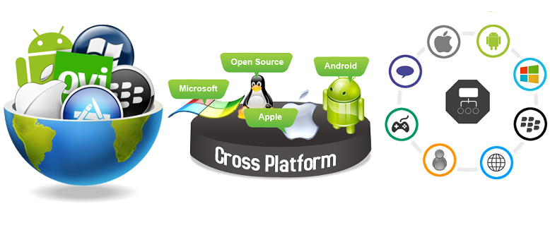
Cross-Platform App Development

Slide 4
User is Queen
More devices & platforms
Minimal amount of source code

Slide 5
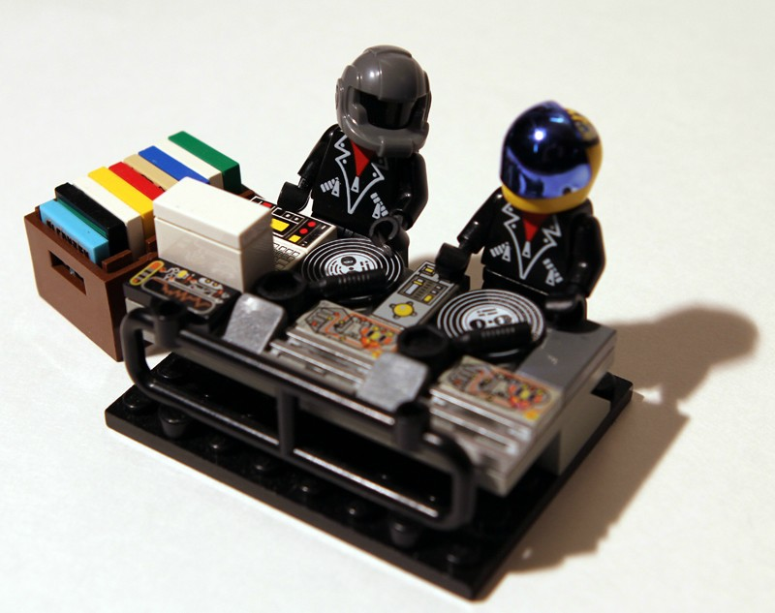
Easier, better, faster, smaller & more portable

Slide 6

Write Once, Run Everywhere

Slide 7
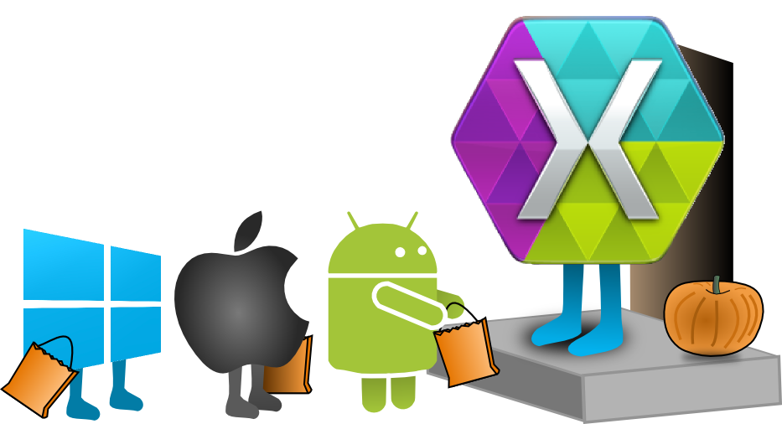
Xamarin

Slide 8
iOS app
Application Layer
UI Layer
Portable Class Library
IPlatformDependent Implementations
Data Layer
Data Access Layer
Business Layer
Android app
Application Layer
UI Layer
Service Access Layer
Model Objects
IPlatformDependant
IPlatformDependent Implementations
Windows app
Cloud services
Application Layer
UI Layer
IPlatformDependent Implementations

Slide 9
MVVM
View
Data binding & commands
Send notifications
Model
View Model
ViewModel updates the Model
State & Operations
Send notifications

Slide 10
MVVM Frameworks
Caliburn
Prism
MVVMCross
MVVMLight
Mono for Android
MonoTouch for iOS
Mono for Mac
WPF
WinRT XAML Framework
WUP
Silverlight

Slide 11
Architectural Decisions

Slide 12


Slide 13
Hexagonal Architecture
UI
Domain Model
ViewModels
SQLite
DB
File System

Slide 14

UI/UX Decisions

Slide 15
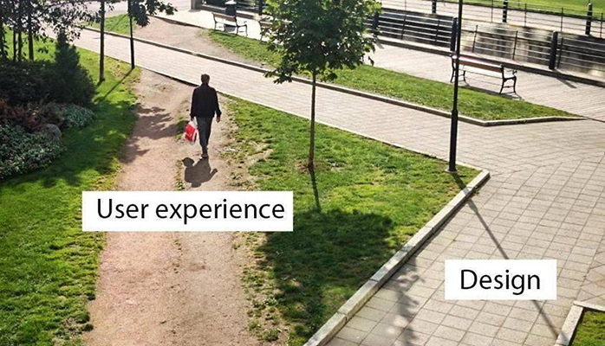
Do not force users to stick to a common UI.
The UX should be platform specific.
Stick to the look and feel of native applications.
Know your platform & users.

Slide 16
What I really wanted to say…
Write cross-platform apps
Choose the right tools
Know your tools, platforms & users
Keep in mind that UX matters
Stick to the native look & feel of each platform

